Slide 1
Hierarchical Sensitivity
Performing Sensitivity Studies in Hierarchies

Slide 2
What is Sensitivity?
When we ask for sensitivity studies we mean to analyze how the priorities of the alternatives change as we vary the priority of a criterion.
For example, if Price becomes much more important, does the best choice of car change? To which one? By how much?
Sensitivity can be studied for each criteria, and for each subcriterion.

Slide 3
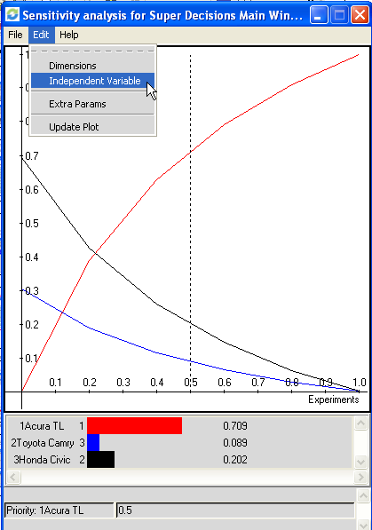
Graphical Sensitivity
To do graphical sensitivity select the Computations>Sensitivity command
Select Edit>Independent Variable to get to the Sensitivity input selector box and change the Independent Variable to the Goal.
The first graph that appears has the first node, alphabetically, selected as the wrt (with respect to) node. It is generally not the one you want. Here you need to select the Goal, not the Acura TL, as the independent variable

Slide 4
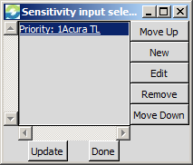
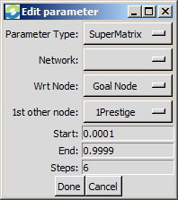
Graphical Sensitivity (cont’d)
Step one. Select the Edit>Independent Variable command
Step two. In the Selected Node box highlight the current node (Acura) then click Edit.
Step three. In the Input Parameter Box select Parameter Type: Supermatrix, the Goal as Wrt Node (“with respect to”) and select one of the criteria as the 1st other node, for example, choose Prestige. Click on the button to the right to get the drop down box with the other choices.

Slide 5
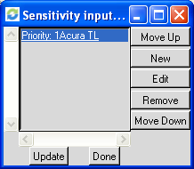
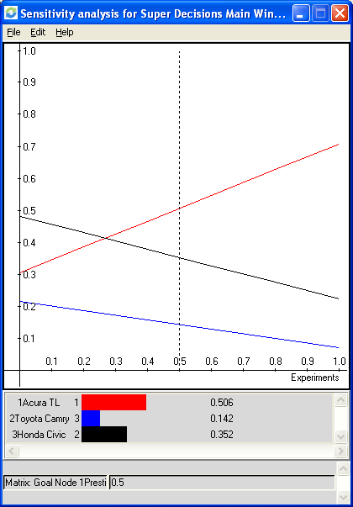
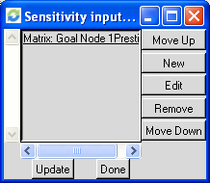
Getting Sensitivity Graph for Prestige
Show Selected Node Box
Set Parameters Box
1
2
Sensitivity Graph for Selected node(s)
Updated Parameters – click Update for results
4
Priority of Prestige is given on x-axis; vertical line starts at Prestige priority of 50%; car priorities for Prestige=50% priority are shown by intersections with vertical line.
3

Slide 6

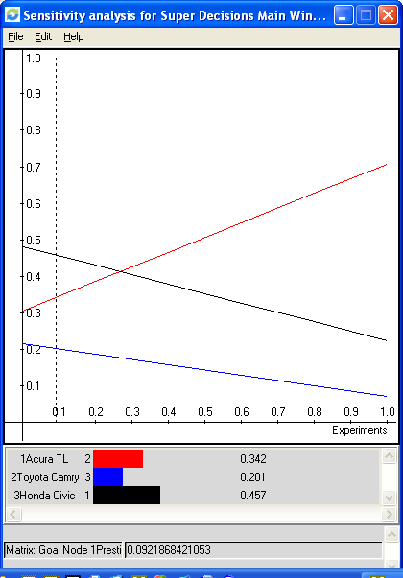
Interpreting Sensitivity of Prestige
At Prestige = 50%, Acura is best
At Prestige = 9.2% (actual priority in model), Civic is best
Click and drag vertical line to change priority of Prestige on horizontal axis from 0.5 to 0.1.
The analysis: If your priority is less than about 25% for Prestige, the Honda is the car to buy. For any priority greater than that, the Acura is your best car.

Slide 7
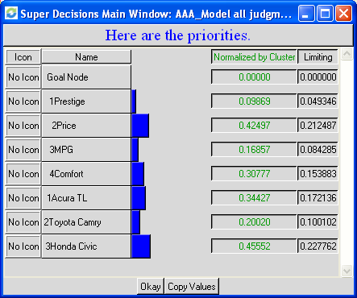
Priorities of all Nodes in Model
Select Computations>Priorities command to see the priorities of all nodes in model
“Limiting priority” column shows priority of Prestige compared to all the other nodes in the entire model.
“Normalized by Cluster” column shows the priority of Prestige (.096) compared to the other criteria in its cluster.
Drag the vertical line from .5 to .096 on the x-axis in Sensitivity to show the priorities of the cars at the model priority of .096 for Prestige.

Slide 8
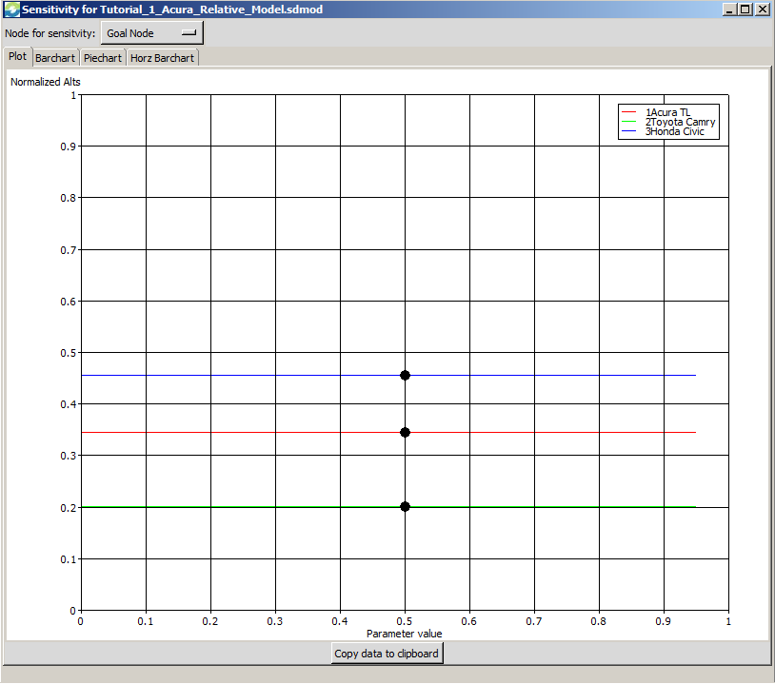
Node Sensitivity
Select Computations>Node Sensitivity to get into Dynamic Node Sensitivity Mode
Click on “Node for Sensitivity” selector button at right and change from Goal Node, shown here, to 1Prestige.

Slide 9
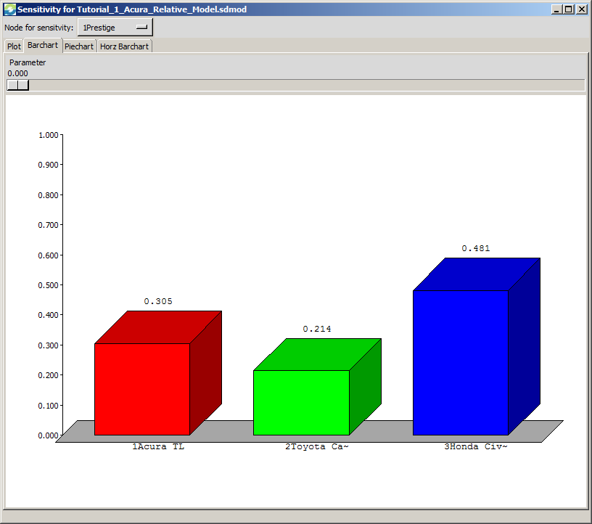
Dynamic Sensitivity - Prestige
The Prestige parameter can be dragged from 0.00 to 1.00. At 0.50, the priorities of the cars are the same as the overall synthesized result priorities of 0.344, 0.200 and 0.456.

Slide 10
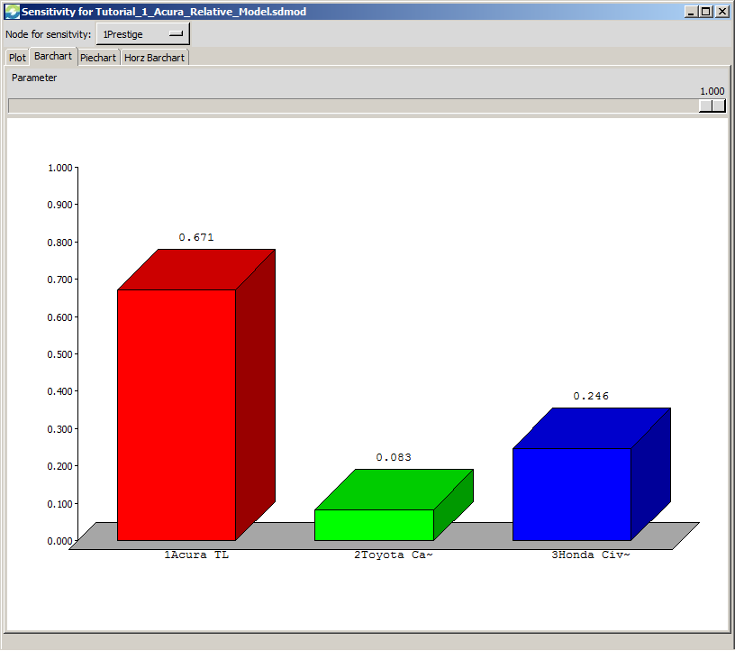
Dynamic Sensitivity
At a parameter value of 1.00 for Prestige the most prestigious car, the Acura is clearly the best choice.

